Slide 1
Operation Guide of FastKing gDNA Dispelling RT SuperMix (KR118)
TIANGEN BIOTECH(BEIJING)CO., LTD
Version No.: 20170927

Slide 2
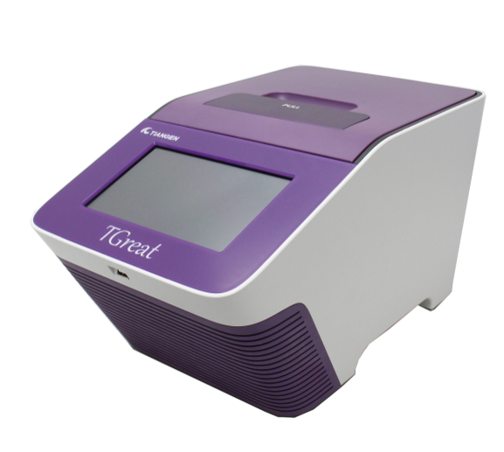
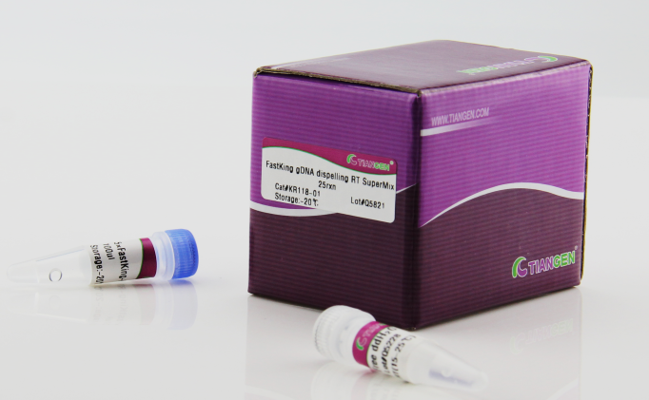
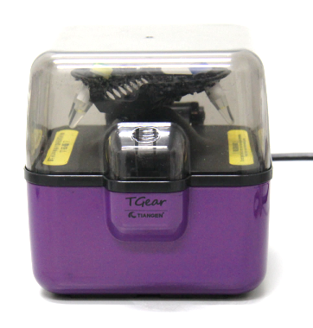
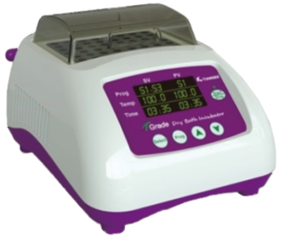
Experiment preparation
RNA sample
Pipette and matched sterile tips (RNase-free)
1.5 ml centrifuge tube (RNase-free) and 200 μl PCR tube (RNase-free)
Vortex oscillator, centrifuge, dry bath/thermal cycler

Slide 3
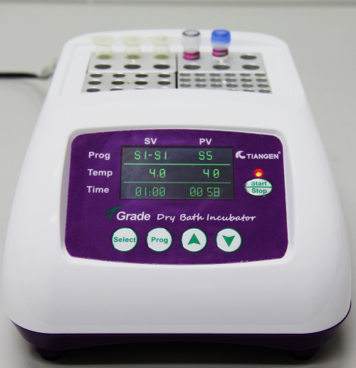
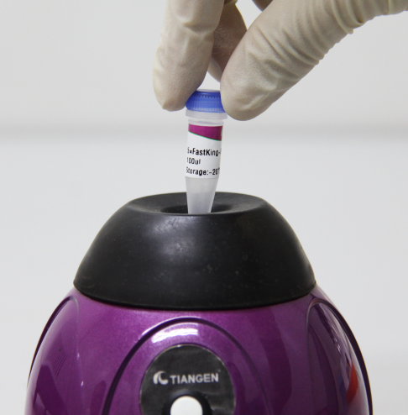
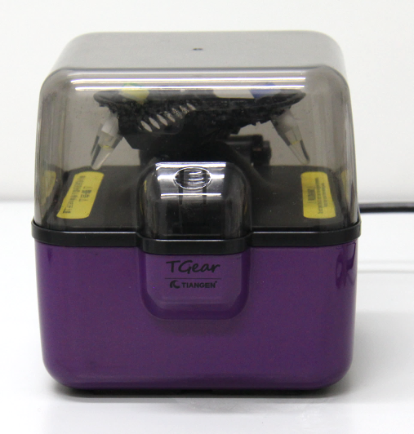
Step 1
Thaw the template RNA on ice; thaw 5×FastKing-RT SuperMix and RNase-Free ddH₂O at room temperature (15-25℃) and then quickly place on ice. Before use, mix each solution evenly by vortex oscillation, and briefly centrifuge to collect the liquid remaining on the tube wall.

Slide 4
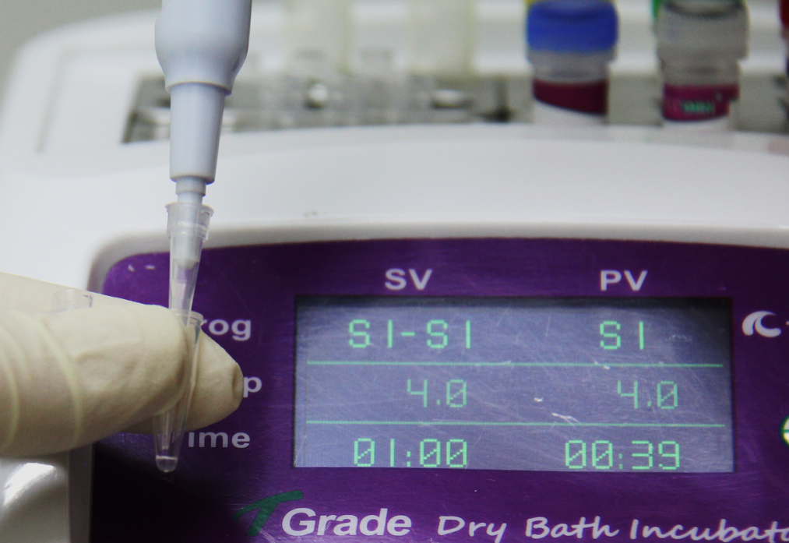
Step 2
Prepare the reverse transcription reaction system according to the following table. Please carry out the operation steps on ice.
Reverse transcription reaction system
Component | Volume
5× FastKing-RT SuperMix | 4 μl
Total RNA | 50 ng-2 μg
RNase-Free ddH₂O | Up to 20 μl

Slide 5
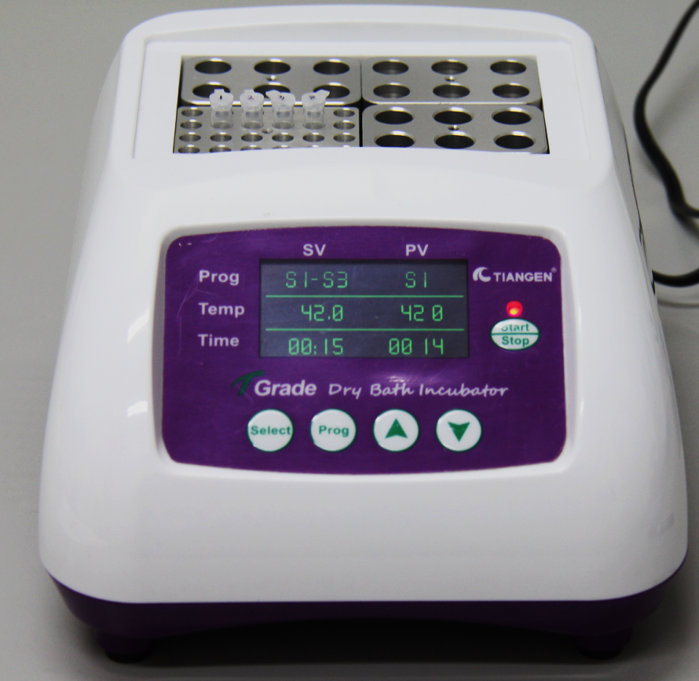
Step 3
Incubate for 15 min at 42℃

Slide 6
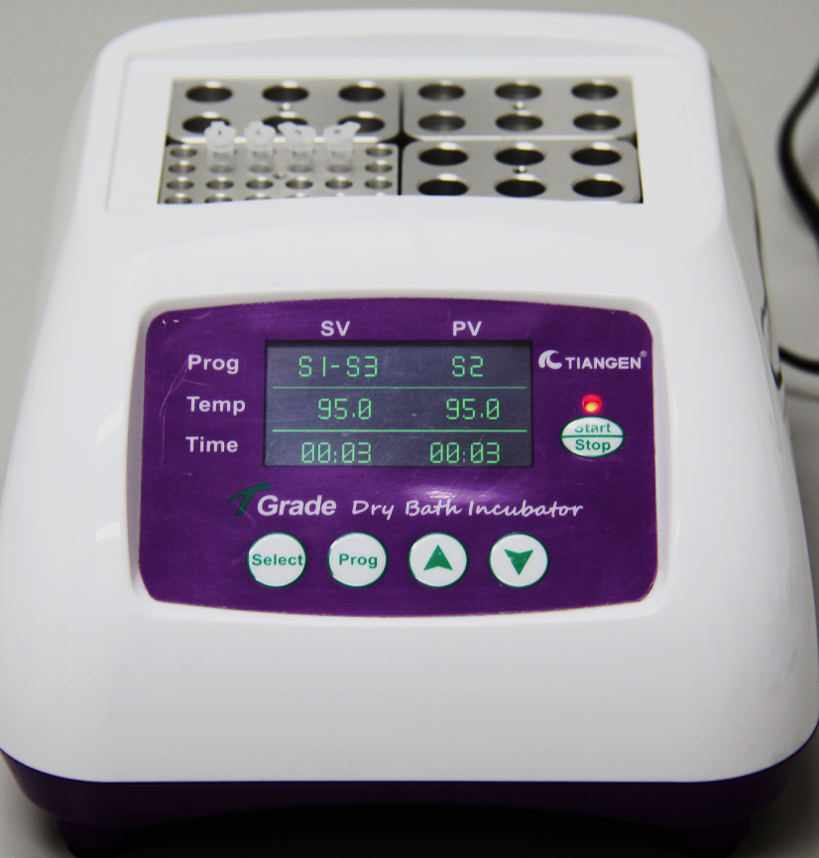
Step 4
Incubate for 3 min at 95℃ and then put on ice to complete the experiment.

Slide 7
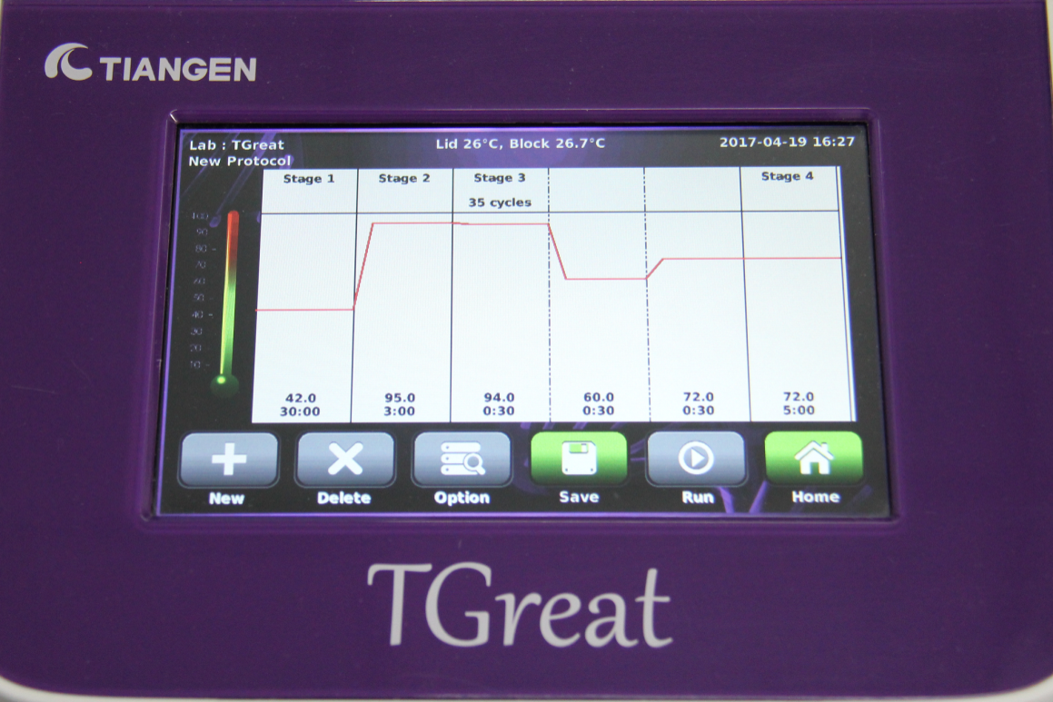
Tips
The obtained cDNA can be used for subsequent experiments or cryopreservation. Divide it into
single-use aliquots and avoid repeated freezing and thawing.
It's not suggested to detect the cDNA concentration.

